Slide 1
DNA Testing
Andrew Williams & Suhail Bhat | Algorithms | May 4, 2020

Slide 2
Introduction
Earlier this year, consumer DNA test sales plummeted after the Pentagon issued a warning telling military troops to avoid the service, but interest has sparked again after 23andMe began using its massive DNA database to do Coronavirus research. For our algorithmic investigation, we wanted to take a look at consumer DNA testing and how the data is being used.
The four main types of DNA testing are forensic, paternity, medical and ancestry but in recent years the line has become blurred. When you take a test from AncestryDNA or 23andMe today, your data could be used for any one of these things but, arguably, the most concerning case is its use by law enforcement.
If you have nothing to hide, you shouldn’t be worried. Right? Not quite.
Over the years, researchers have disputed the accuracy of forensic methods such as bullet analysis, hair comparisons and arson tests. Their accuracy has been proven inconsistent and thus debunked as conclusive evidence in the court of law. The Innocence Project’s reports say that some forensic methods might produce consistent results, but there hasn’t been enough research done to establish their validity.
In 2018, law enforcement took advantage of GEDmatch’s open database to finally catch the Golden State Killer nearly 40 years later. But in a similar 2015 case, DNA data was used from Ancestry.com that led to the wrongful accusation of a man for the 1996 murder of Angie Dodge. Ancestry shut down the project soon after. The case serves as a modern example of how ancestry DNA testing algorithms (the difference in genetic markers used between different types of tests) are not the same as those used in crime labs and shouldn’t be interchangeable.
Our story would also explore other ethical issues surrounding DNA testing like genetic discrimination.

Slide 3
Stakeholders
Law Enforcement uses DNA testing in cracking cases, including cases that had been cold for years
Consumers can get a DNA test from a private lab such as 23andMe and AncestryDNA
Doctors help with diagnosis
Scientists further knowledge, finding cures to genetic diseases including cancer
Tech companies design algorithms that can generate DNA structures
Defendants have received wrongful convictions

Slide 4
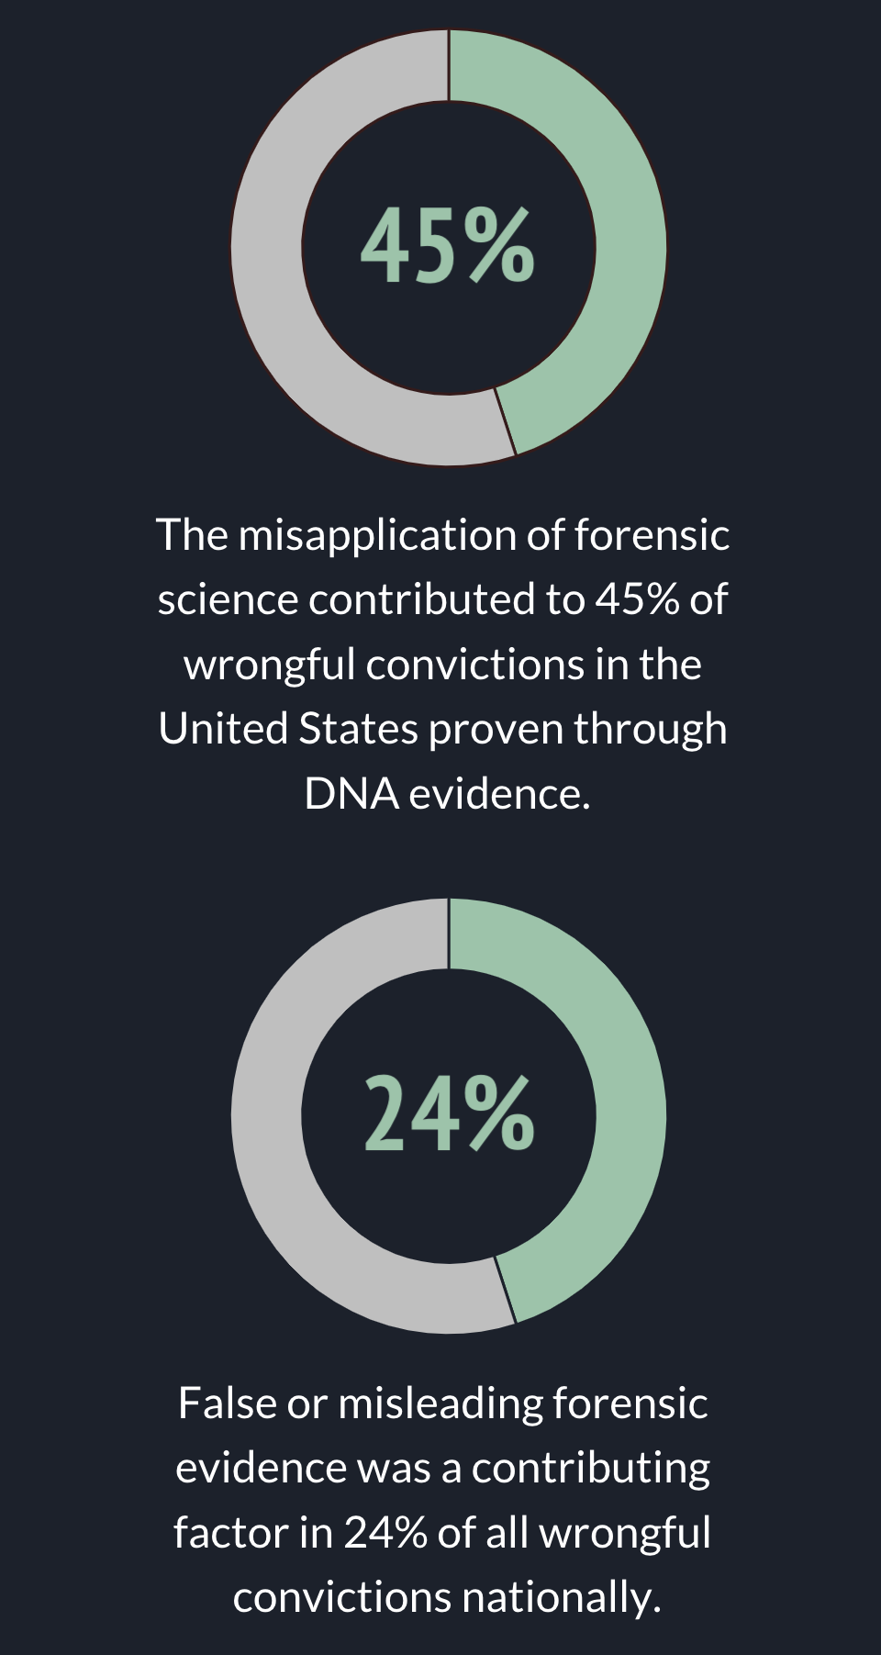
Issues
Law Enforcement
Privacy Policies
Test Accuracy
Genetic Discrimination
Insurance Companies
Designer Babies
Sources | The Innocence Project, National Registry of Exonerations
Graphic | Andrew Williams & Suhail Bhat

Slide 5
Sources
Curtis Rogers, GEDmatch Founder
Originally a project under FamilyTreeDNA – the company that gave away all of its customer’s DNA data to the FBI in 2018
Split off from the company due to tech limitations
Met John Olson who could engineer a more modern site and become business partners
Created “rogersDNA.com” which eventually became GEDmatch – a site meant to help people find their family trees

Slide 6
Sources
Brett Williams, Verogen & GEDmatch CEO
Talked to us about how GEDmatch has changed after its acquisition by Verogen
Privacy Policy has remained mostly intact
Users have to opt-in to be included in searches by law enforcement – the only DNA testing site that does so
A warrant would be required for law enforcement to gain access to all GEDmatch users

Slide 7
Sources
Iyana Esters, Master of Public Health / Journalist
An anecdotal source
Woman of color who took an ancestral DNA test and received generalized results
Later learned about all of the issues surrounding consumer DNA testing
Especially concerned about issues in genetic discrimination
Contacted all DNA testing companies and asked them to destroy her sample and delete her data.

Slide 8
Sources
John Greally, Professor, Genetics / Director, Center for Epigenomics at Albert Einstein College of Medicine
In consumer DNA testing, not knowing how companies are going to use your data is serious question
Took DNA test, but wouldn’t again due to privacy and ethical concerns.
There is a knowledge gap – experts can make a diagnosis based on DNA structure only 25% of the time
We don’t understand many variations in DNA structure and it becomes difficult to make a diagnosis within underserved populations such as those with Sub-Saharan African ancestry
Testing leans toward giving good news to consumers so that they are enticed as much as possible
Legal reforms are absent to protect this data

Slide 9
What’s Next
More research into genetic discrimination pertaining to:
Designer Babies
Health Insurance
Opaque Algorithms
Should DNA be conclusive evidence?
Genetic Markers – How exactly do testing algorithms differ between test types?

Slide 10
Thank You.
We Will Now Begin Taking Questions.

